Slide 1

LLMs Go To SQL School
Yifan Wang

Slide 2
Introduction
Grading SQL queries manually is time-consuming and challenging
Make use of the power of pre-trained models.
Fine-tune the pre-trained models with labeled data for better performance.
Try different ways to organize the training data and different models.

Slide 3
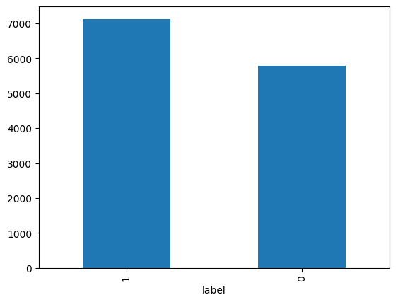
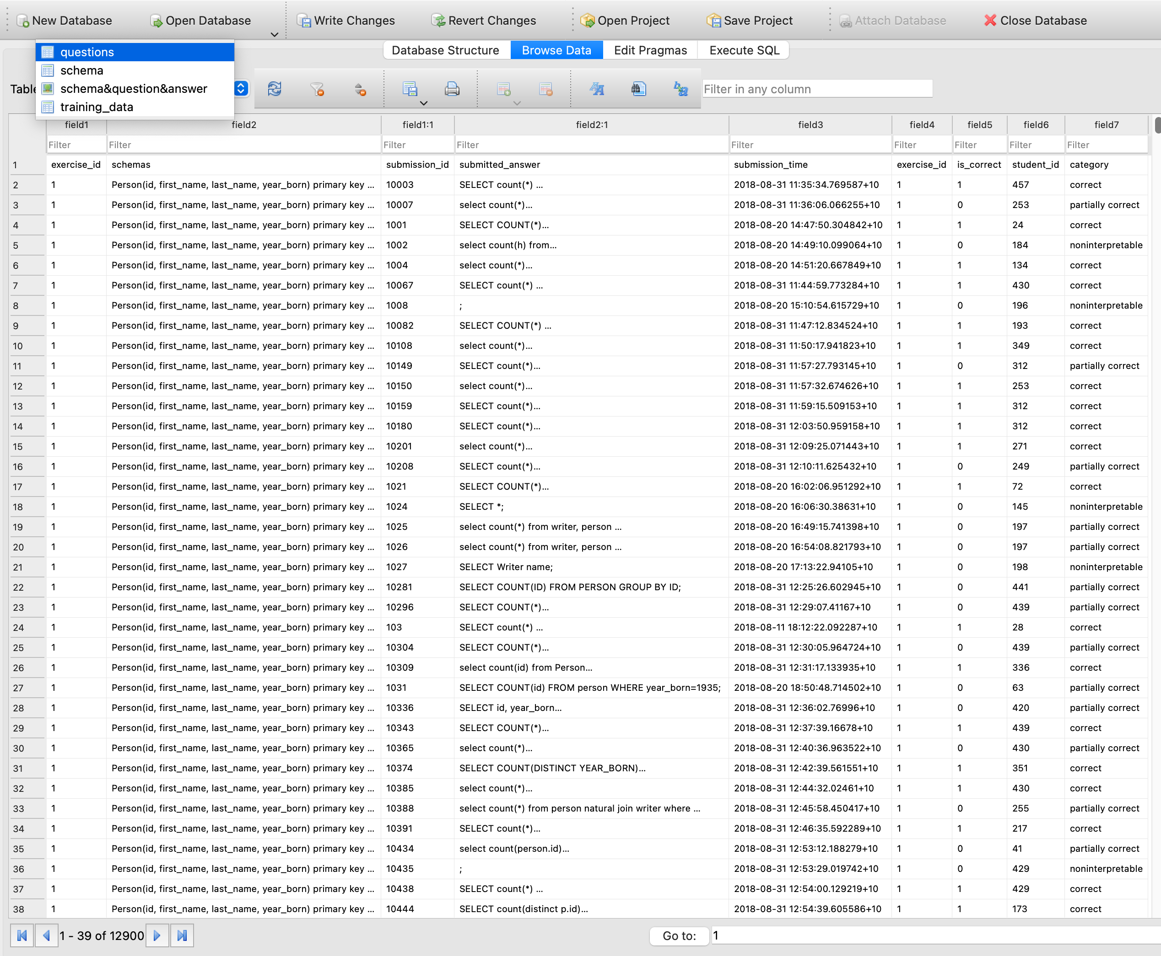
Dataset
Balance

Slide 4

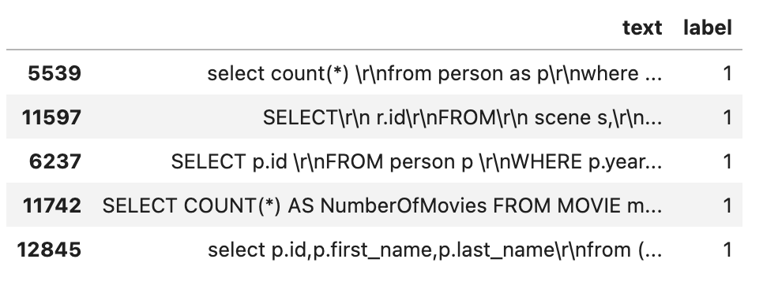
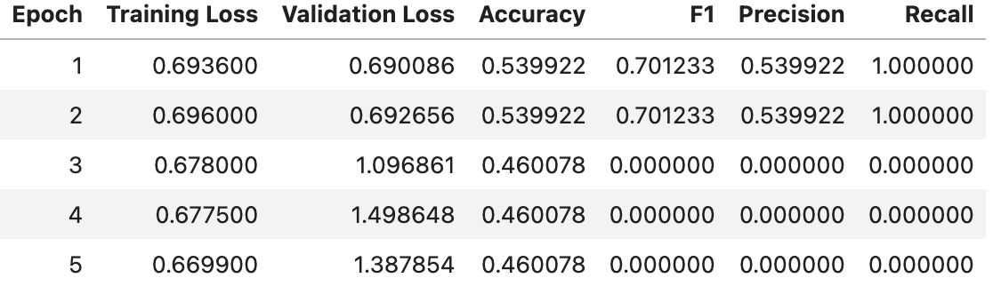
No context, Bert
Lower than random guess!

Slide 5

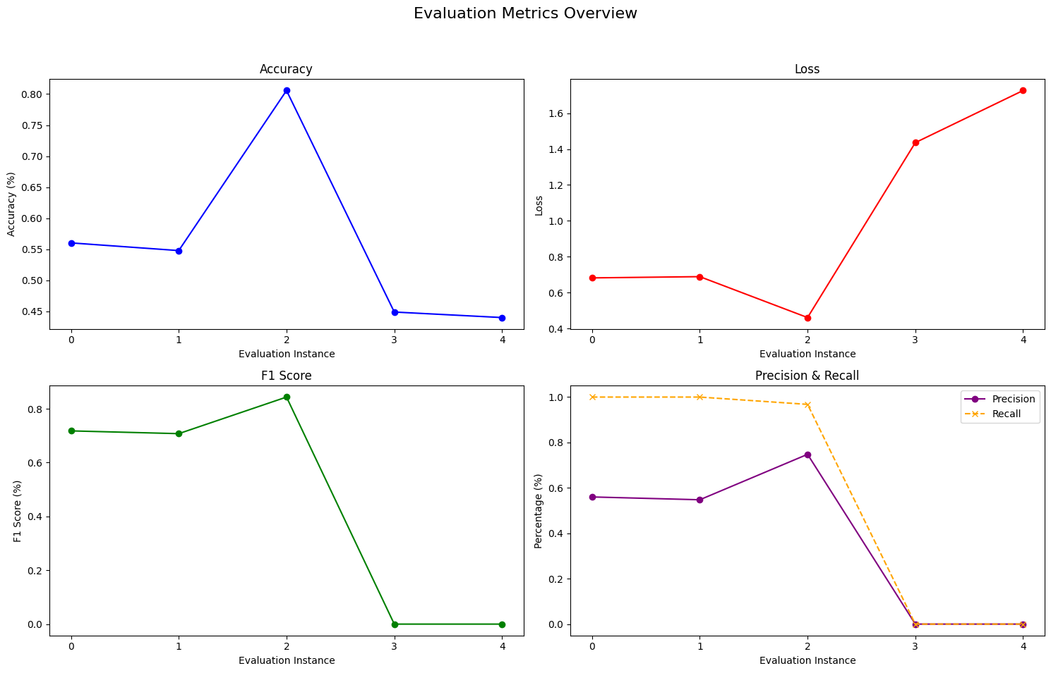
Cross Validation
Slightly
higher than random
Avg acc: 0.56

Slide 6
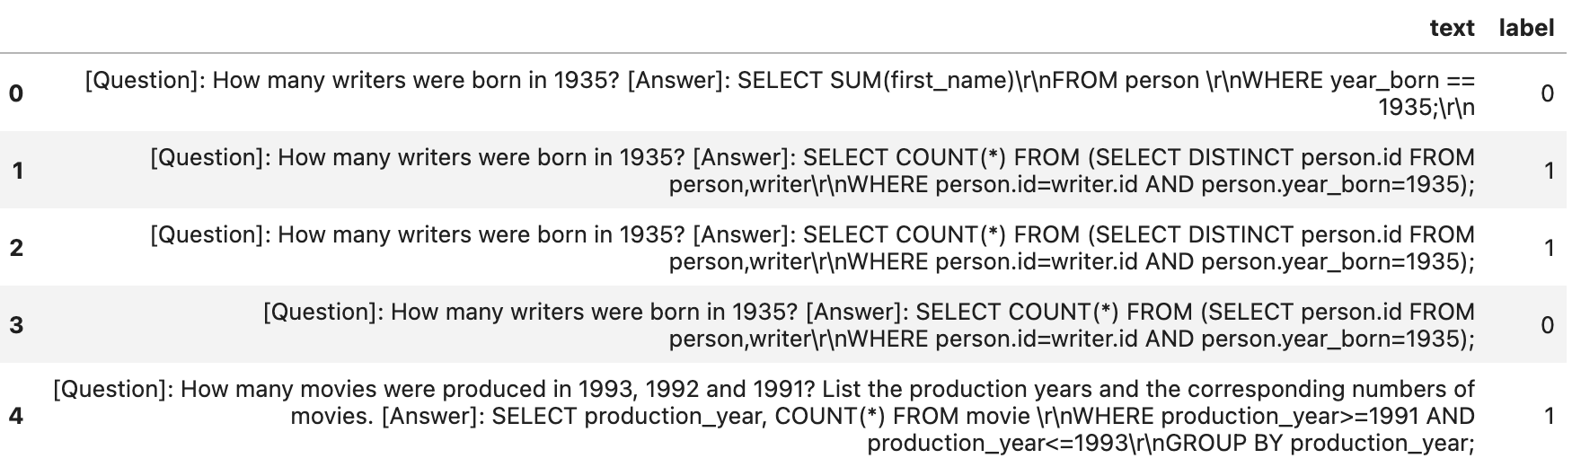
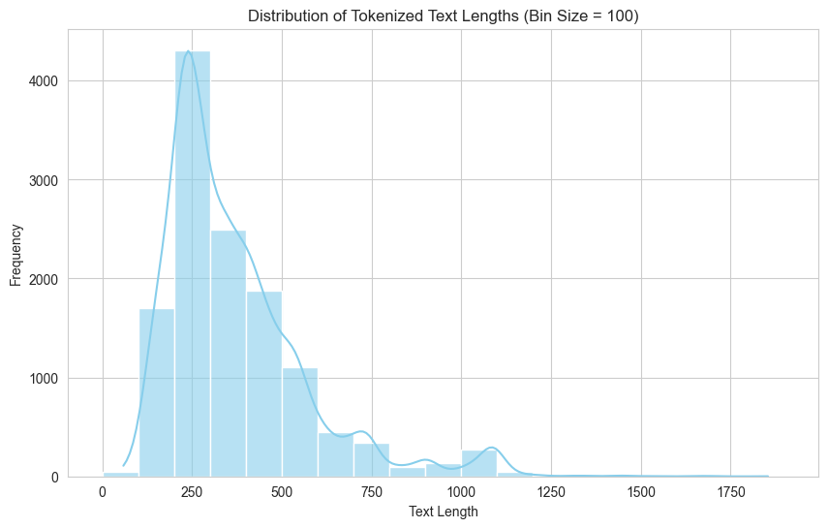
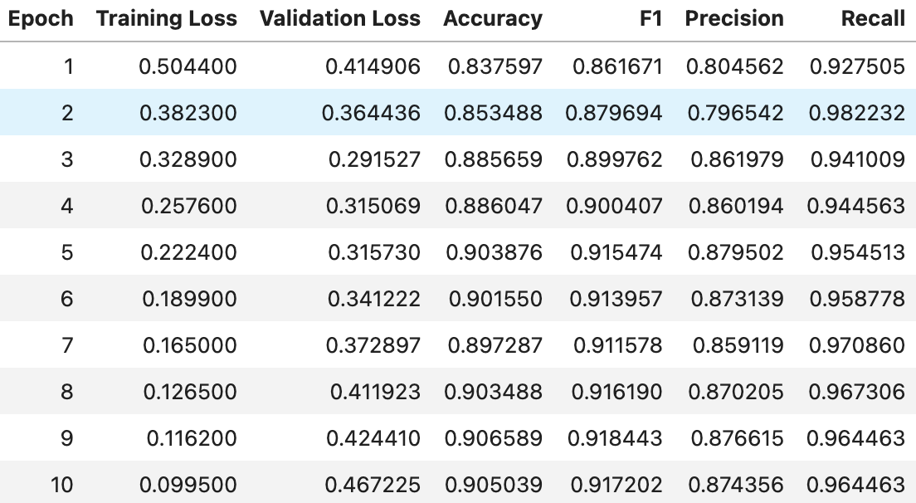
Q&A, Bert

Slide 7
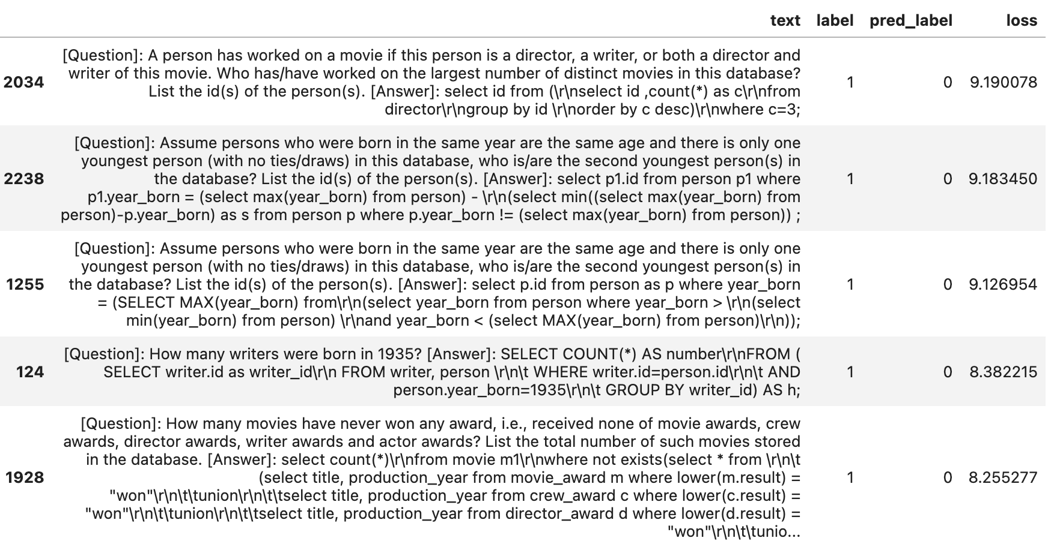
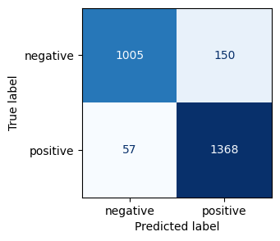
Error Analysis
Make bad predictions when dealing with longer input.
Try larger models.

Slide 8
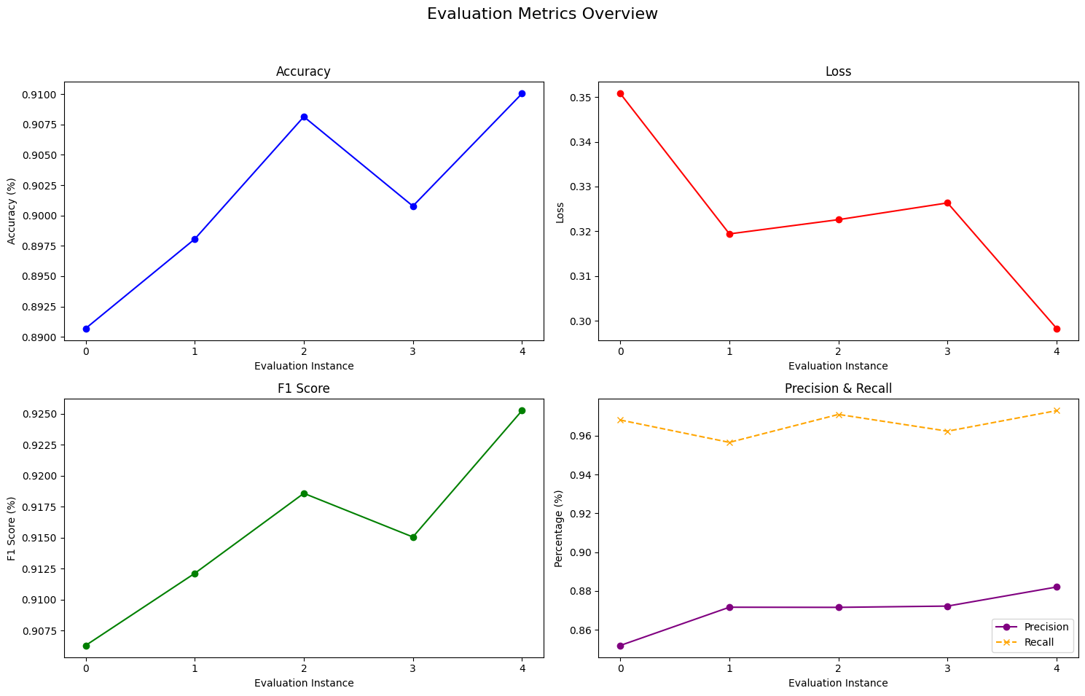

Cross Validation
Avg acc: 0.9

Slide 9
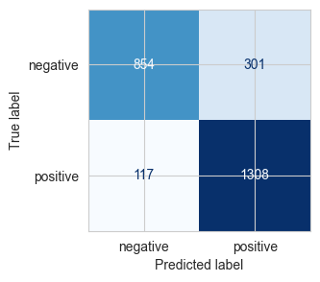
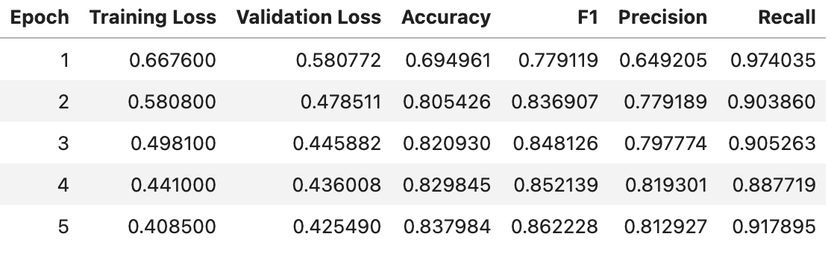
Q&A, RoBerta
Bert > RoBerta

Slide 10
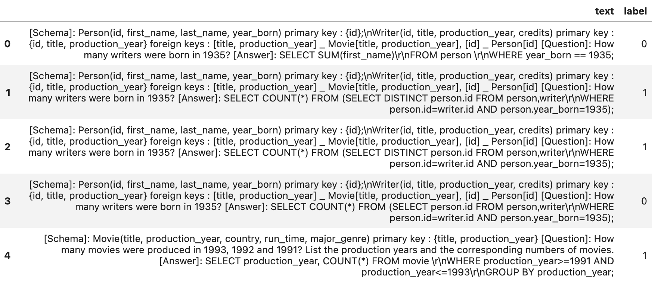
Schema & Question & Answer, Big Bird

Slide 11
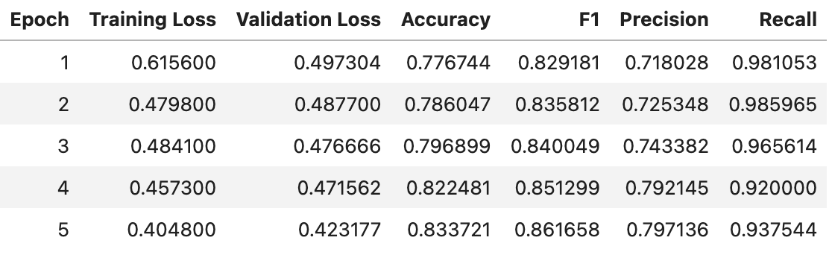

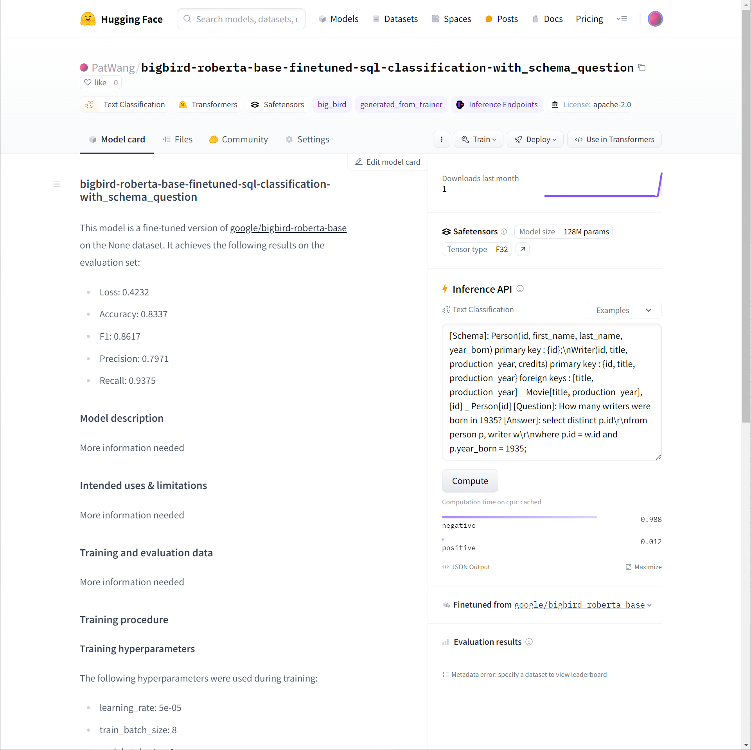

Slide 12
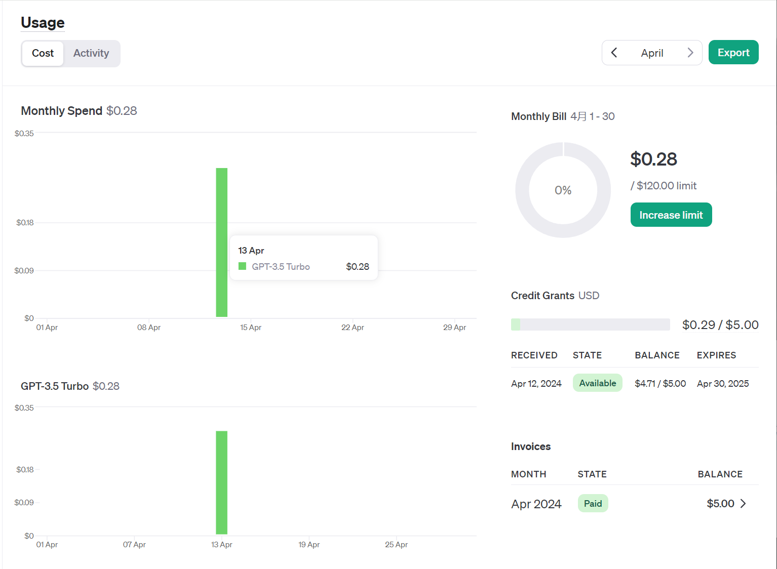
Prompt Engineering, GPT 3.5
Given the database schema, corresponding question, and the SQL query, determine if the query is syntactically and logically correct. Return 0 if it is not correct. Return 1 if it is correct, return 0 or 1 without any explanation.
Acc: 0.7

Slide 13
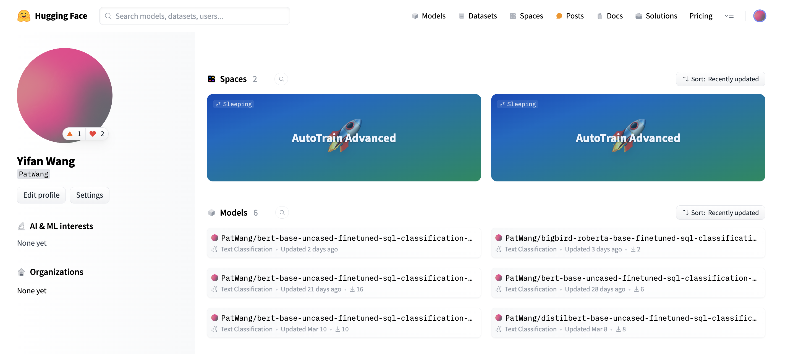
Result
Fine-tuned models outperform gpt3.5
They are all published to the Hugging Face model hub
Already got 50+ download

